Slide 1
Present Perfect
allesvoorengels.nl

Slide 2

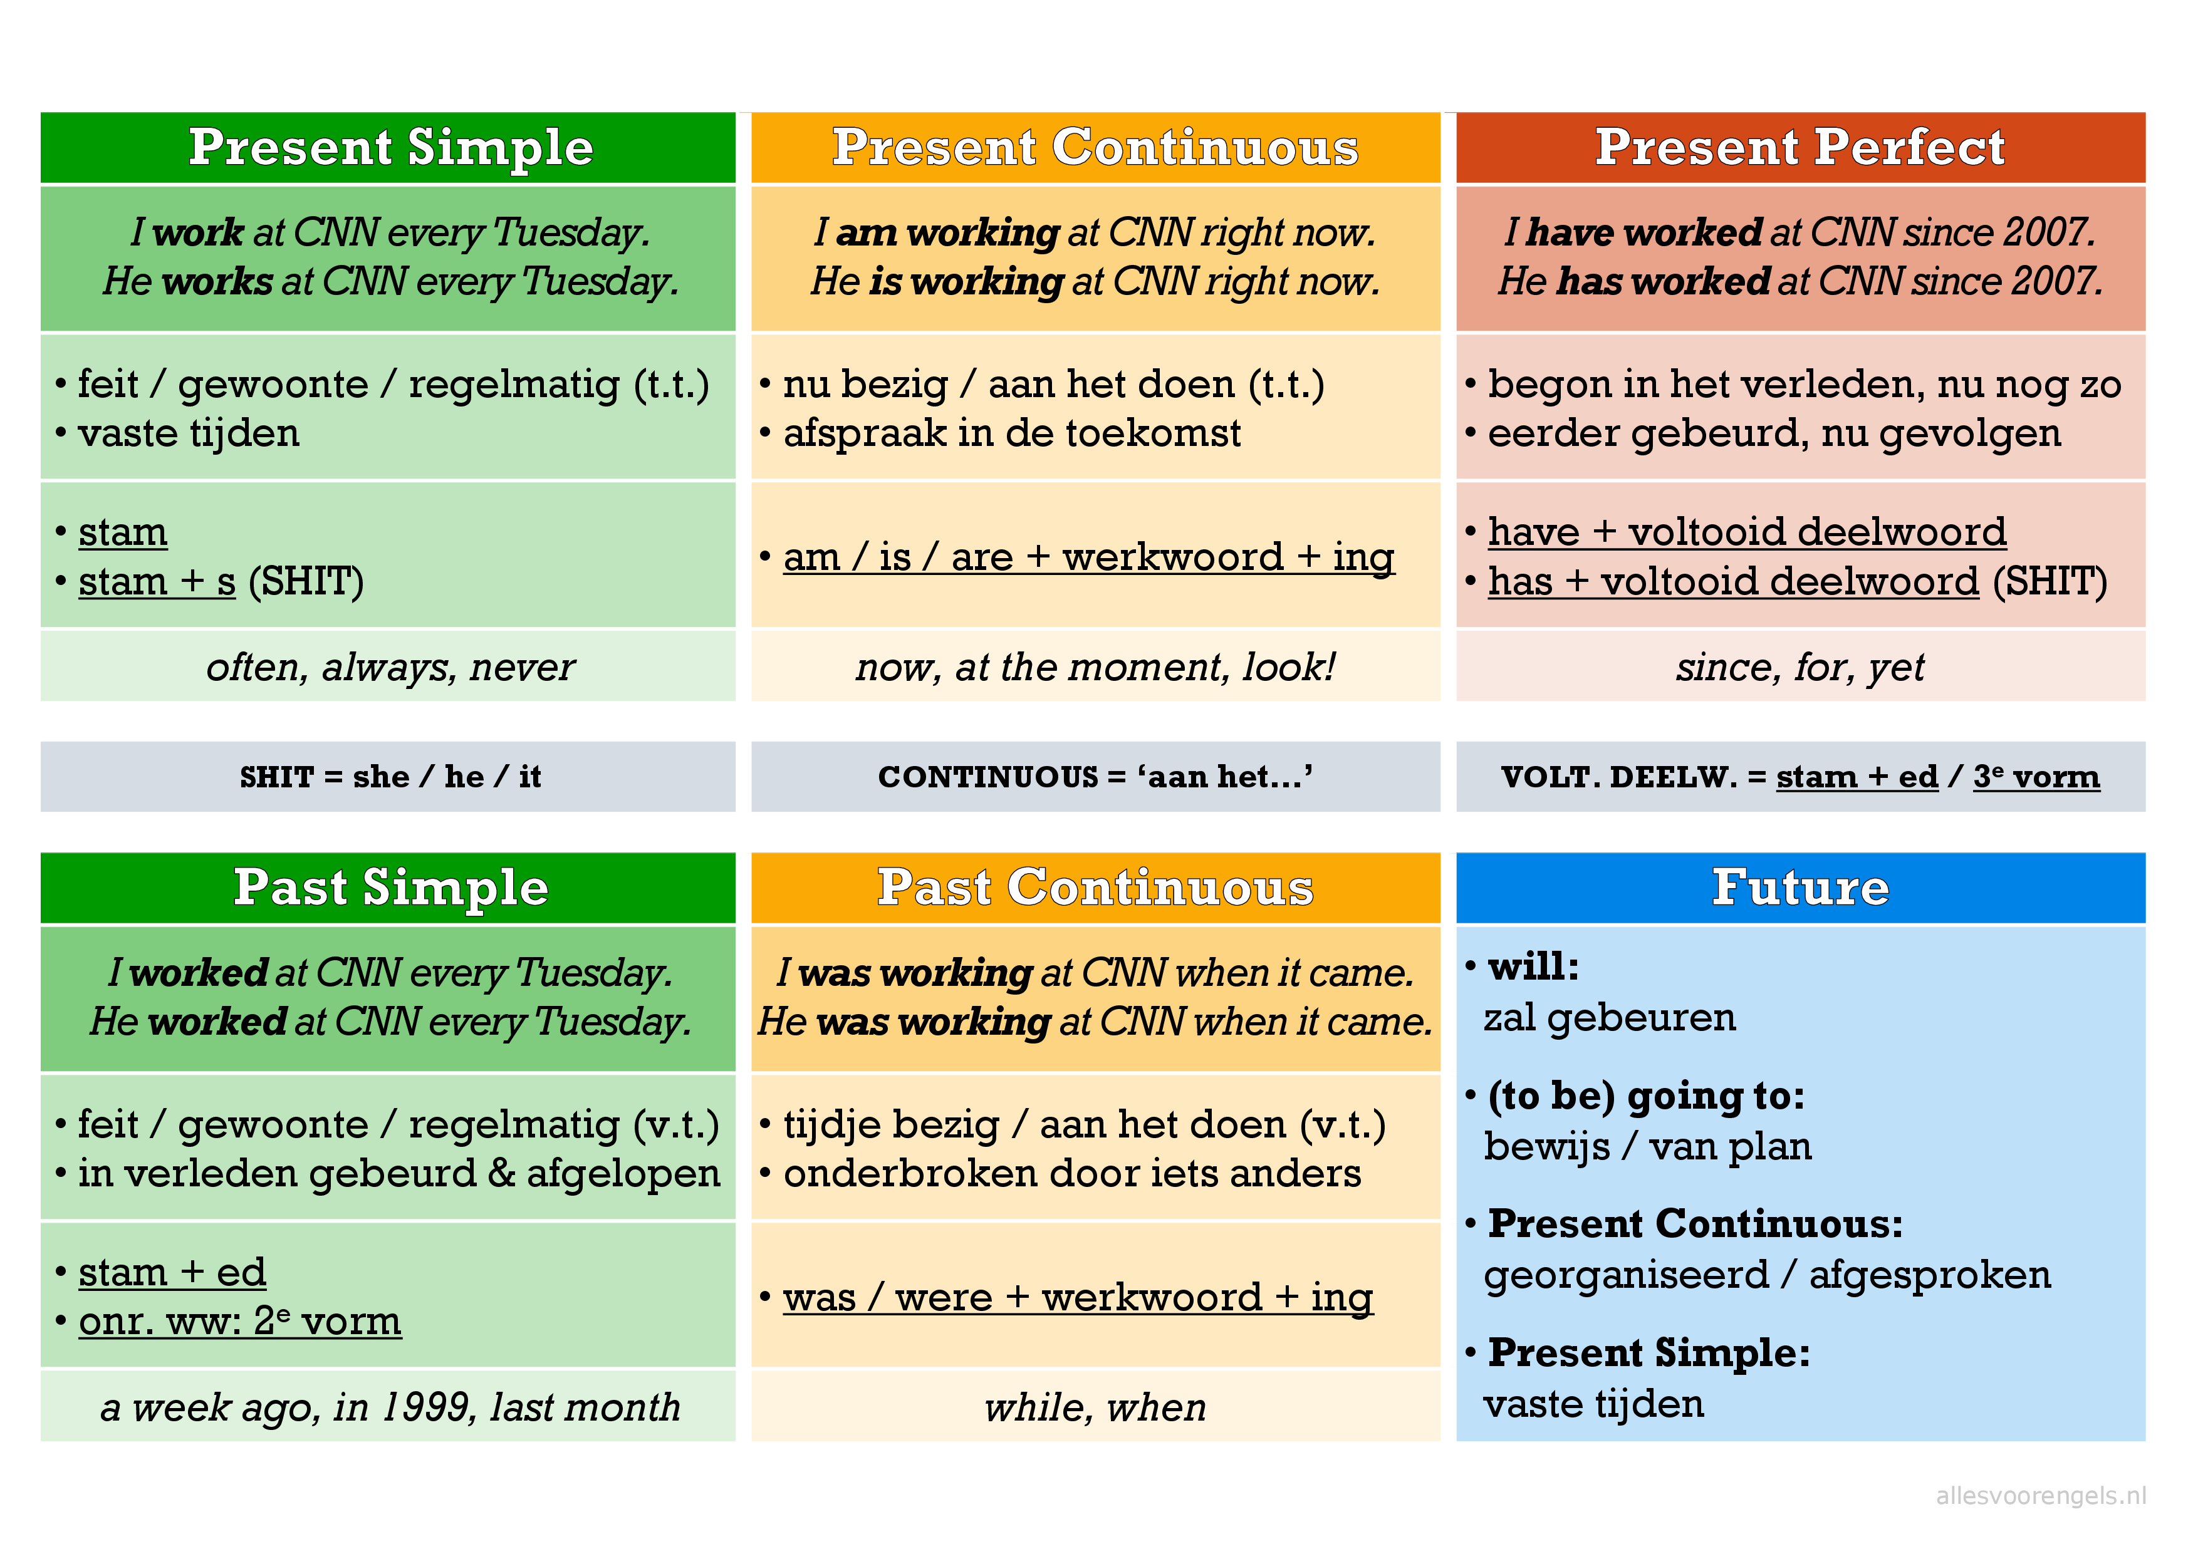
De Tijden

Slide 3
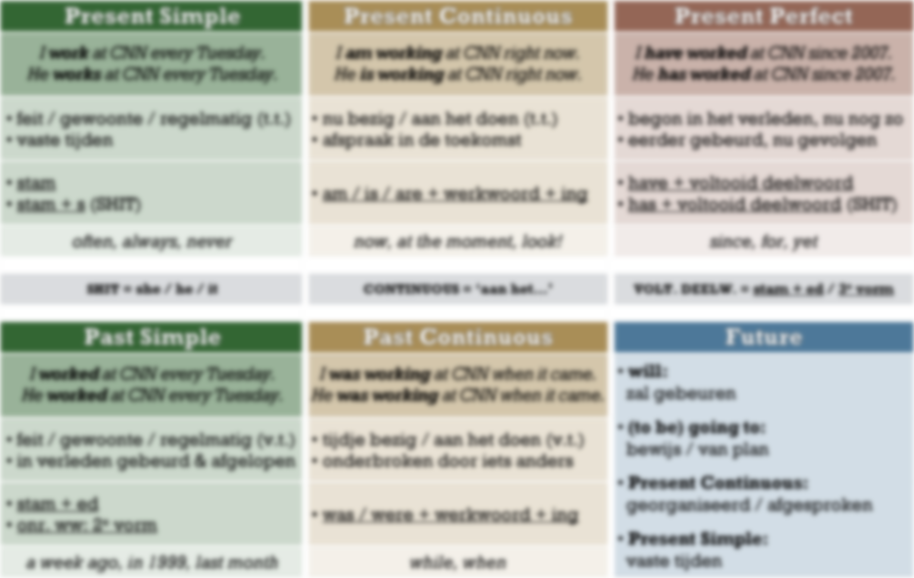
Present Perfect
Wanneer gebruik je het?
Hoe ziet het eruit?
Samenvatting

Slide 4
Wanneer gebruik je de Present Perfect?

Slide 5
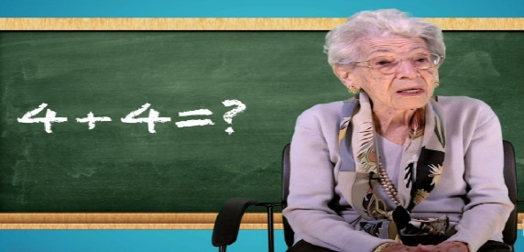
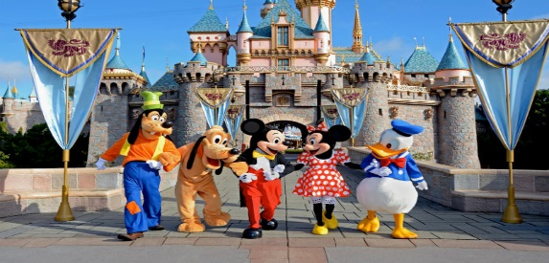

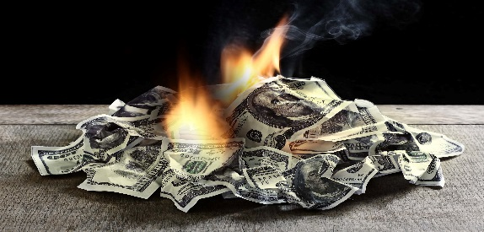
Wanneer gebruik je de Present Perfect?
begon in het verleden, nu nog zo
eerder gebeurd, nu gevolgen
She has worked as a teacher since 1953.
We have never been to Disneyland.
I have broken my arm, so I can’t play tennis.
He is in trouble because he has lost all his money.
allesvoorengels.nl

Slide 6
Wanneer gebruik je de Present Perfect?
begon in het verleden, nu nog zo
eerder gebeurd, nu gevolgen
Gebruik je in deze zinnen de Present Perfect?
There have been many earthquakes in America.
Nobody has ever climbed that mountain.
I bought a brand new car last year.
I’ve spent all my money so I can’t buy a gift.
allesvoorengels.nl

Slide 7
Wanneer gebruik je de Present Perfect?
begon in het verleden, nu nog zo
eerder gebeurd, nu gevolgen
Gebruik je in deze zinnen de Present Perfect?
There have been many earthquakes in America.
Nobody has ever climbed that mountain.
I bought a brand new car last year.
I’ve spent all my money so I can’t buy a gift.
allesvoorengels.nl

Slide 8
Wanneer gebruik je de Present Perfect?
begon in het verleden, nu nog zo
eerder gebeurd, nu gevolgen
Gebruik je in deze zinnen de Present Perfect?
There have been many earthquakes in America.
Nobody has ever climbed that mountain.
I bought a brand new car last year.
I’ve spent all my money so I can’t buy a gift.
allesvoorengels.nl

Slide 9
Wanneer gebruik je de Present Perfect?
begon in het verleden, nu nog zo
eerder gebeurd, nu gevolgen
Gebruik je in deze zinnen de Present Perfect?
There have been many earthquakes in America.
Nobody has ever climbed that mountain.
I bought a brand new car last year.
I’ve spent all my money so I can’t buy a gift.
allesvoorengels.nl

Slide 10
Wanneer gebruik je de Present Perfect?
begon in het verleden, nu nog zo
eerder gebeurd, nu gevolgen
Gebruik je in deze zinnen de Present Perfect?
There have been many earthquakes in America.
Nobody has ever climbed that mountain.
I bought a brand new car last year.
I’ve spent all my money so I can’t buy a gift.
allesvoorengels.nl

Slide 11
Hoe ziet de Present Perfect eruit?

Slide 12

Hoe ziet de Present Perfect eruit?
have / has + voltooid deelwoord
voltooid deelwoord:
  regelmatige ww: stam + ed (talk → talked)
  onregelmatige ww: 3e rij (tell → told)
I have
You have
She has
He has
It has
We have
You have
They have
work I have worked here for twelve years.
learn The student has learned Spanish.
eat My parents have eaten the cake.
allesvoorengels.nl

Slide 13
Hoe ziet de Present Perfect eruit?
have / has + voltooid deelwoord
learn The student has learned Spanish.
eat My parents have eaten the cake.
Zet in de Present Perfect:
start The president ____________ his new campaign.
fly They ____________ to Brasil many times.
play My friends ____________ a game on their Xbox.
leave The monkey ____________ the building.

Slide 14
Hoe ziet de Present Perfect eruit?
have / has + voltooid deelwoord
learn The student has learned Spanish.
eat My parents have eaten the cake.
Zet in de Present Perfect:
start The president has started his new campaign.
fly They ____________ to Brasil many times.
play My friends ____________ a game on their Xbox.
leave The monkey ____________ the building.

Slide 15
Hoe ziet de Present Perfect eruit?
have / has + voltooid deelwoord
learn The student has learned Spanish.
eat My parents have eaten the cake.
Zet in de Present Perfect:
start The president has started his new campaign.
fly They have flown to Brasil many times.
play My friends ____________ a game on their Xbox.
leave The monkey ____________ the building.

Slide 16
Hoe ziet de Present Perfect eruit?
have / has + voltooid deelwoord
learn The student has learned Spanish.
eat My parents have eaten the cake.
Zet in de Present Perfect:
start The president has started his new campaign.
fly They have flown to Brasil many times.
play My friends have played a game on their Xbox.
leave The monkey ____________ the building.

Slide 17
Hoe ziet de Present Perfect eruit?
have / has + voltooid deelwoord
learn The student has learned Spanish.
eat My parents have eaten the cake.
Zet in de Present Perfect:
start The president has started his new campaign.
fly They have flown to Brasil many times.
play My friends have played a game on their Xbox.
leave The monkey has left the building.

Slide 18
Samenvatting van de Present Perfect

Slide 19
Samenvatting van de Present Perfect
have / has + voltooid deelwoord
voltooid deelwoord:
  regelmatige ww: stam + ed
  onregelmatige ww: 3e rij
allesvoorengels.nl

